Slide 1
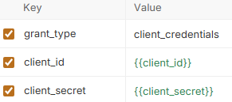

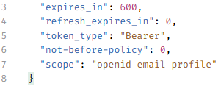
Get Zontal Access Token
Retrieve zontal_access_token:
https://{{ZONTAL_HOST}}/auth/realms/zontal-space/protocol/openid-connect/token

Slide 2
Query Information Packages on Zontal
https://{{ZONTAL_HOST}}/api/search/informationPackages/
1 or more sample names:
"filter": [
{
"propertyName": "sampleName",
"value": [
"QAS4001","QAS3001-b","QAS4001: TI_5599638"
],
"filterType": "prefix",
"caseInsensitive": true
}
]

Slide 3
"filterType":
1. "range"
Used to filter numeric values, timestamps, or date ranges. It typically requires defining bounding criteria such as:
gte (Greater than or equal to)
lte (Less than or equal to)
gt (Greater than)
lt (Less than)
2. "term"
Distinct from "terms", this filters by a single, exact matching value instead of an array of multiple potential matching terms. It prevents tokenization or text-splitting and is commonly used for exact ID or exact flag matching.
3. "prefix"
Matches documents that contain a specific field starting with the exact characters provided. For example, applying a prefix filter of ana might return items starting with analysis.
4. "wildcard"
Allows matching based on pattern constraints. It supports standard operators like * (matches zero or more characters) and ? (matches a single character).
5. "exists"
Filters data based on whether a particular field contains any valid value or is missing completely. It typically accepts a boolean flag or operates as a standalone check to find entries where a specific metadata attribute is non-null.
6. "match"
Used for standard full-text search filtering. Unlike exact match options like term, "match" will analyze the input text (such as stripping punctuation, lowercasing, or splitting into keywords) to look for similarities.

Slide 4
Example 2
{
"propertyName": "instrumentId",
"value": [
"IF_NIR"
],
"filterType": "terms"
},
{
"propertyName": "informationPackageProfile",
"value": [
"VNF"
],
"filterType": " wildcard "
}
],
"sortField": [
"createdOn"
],
"sortOrder": [
"asc"
]
}
{
"size": 25,
"filter": [
{
"propertyName": "lifecycleStatus",
"value": [
"Submitted",
"Archived"
],
"filterType": "terms"
},
{
"propertyName": "fileName",
"value": [
"S0995945"
],
"filterType": "wildcard"
},

Slide 5
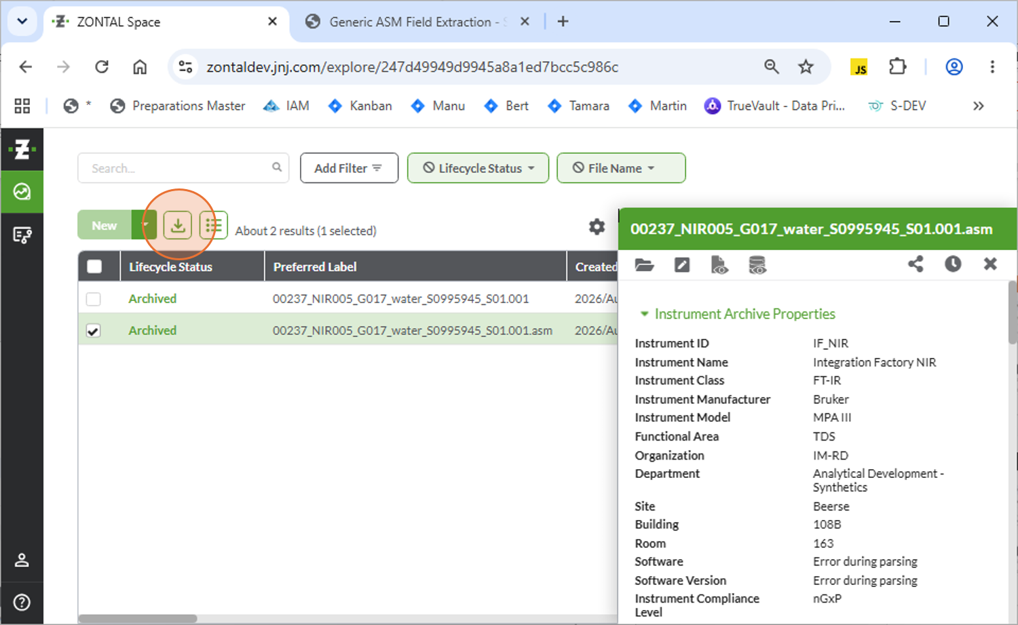
GUI Zontal - Download
Download results where file has extension .asm (processed results file with a VNF (vendor neutral format) information package profile.

Slide 6
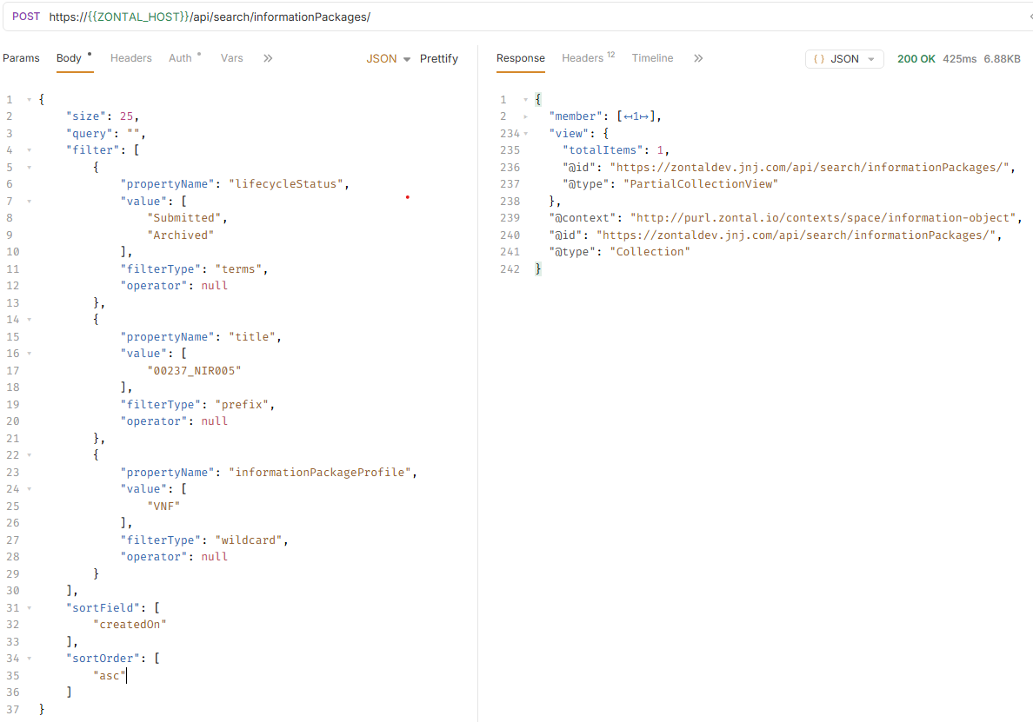
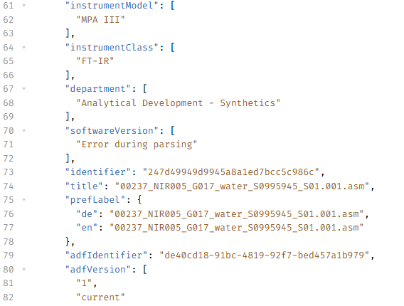
API Zontal – Download – Identifier & Title Lookup

Slide 7
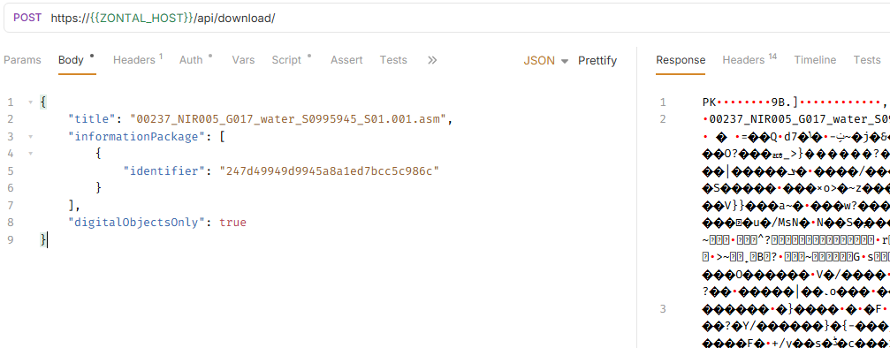
API Zontal – Download & Unzip
UNZIP

Slide 8
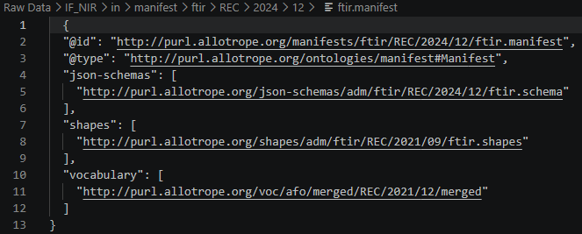
Processing Measurement File
Get $asm.manifest
Get json-schemas[0] from ftir.manifest

Slide 9
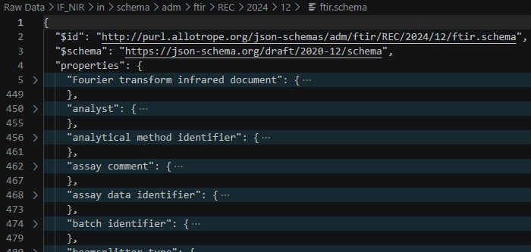
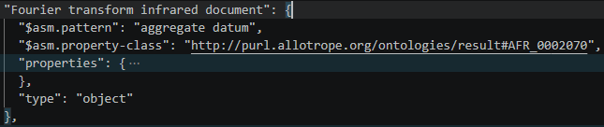
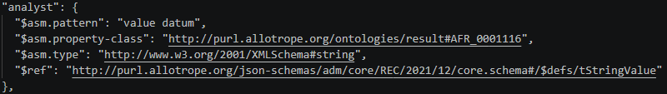
Processing Measurement File (C’ted)
Schema

Slide 10

Transform Schema
Build a field catalog directly from an Allotrope ASM JSON Schema (e.g. ftir.schema), instead of from an actual measurement file.
It acts as template to join with an actual measurements file.
Units are known where the schema pins them via a "$defs/<unit>" $ref (quantity datum) or via a datacube’s cube-structure constants.
Recognized "$asm.pattern" values:
"aggregate datum": a container -> recurse into its "properties".
"quantity datum": a {value, unit} leaf -> unit taken from the units.schema $ref.
"value datum": a plain value leaf -> unit is always null.
"datacube": an Allotrope data cube -> described (dimensions/measures), not expanded.

Slide 11
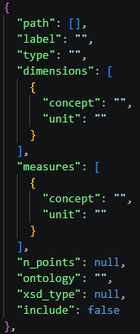
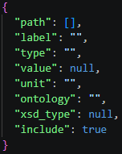
Schema -> Field Catalog
For each property with pattern “datacube”, add an entry to the field catalog:
For each property with pattern “quantity datum” or “value datum”, add an entry to the field catalog:

Slide 12
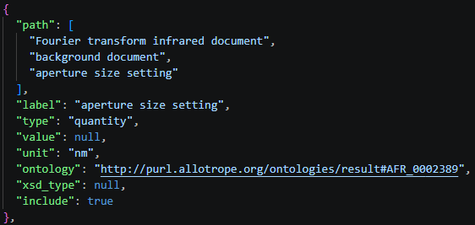
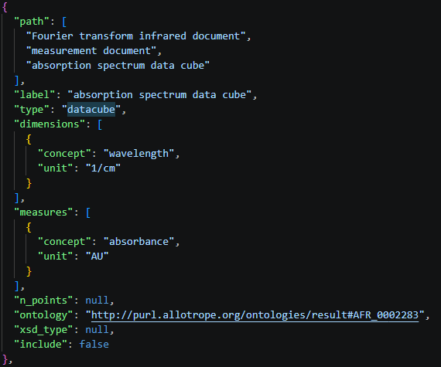
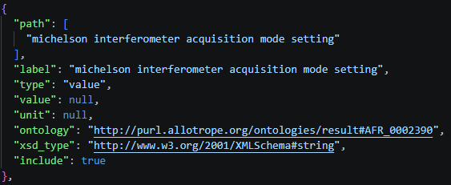
Schema -> Field Catalog: Examples

Slide 13
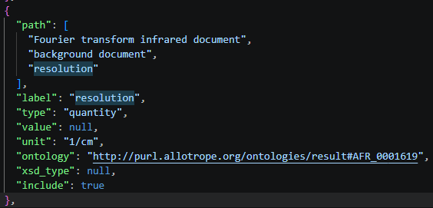
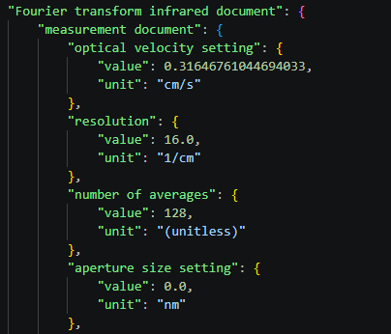

Measurement File
“Join”
Field Catalog

Slide 14
Export towards Signals ELN

